Slide 1
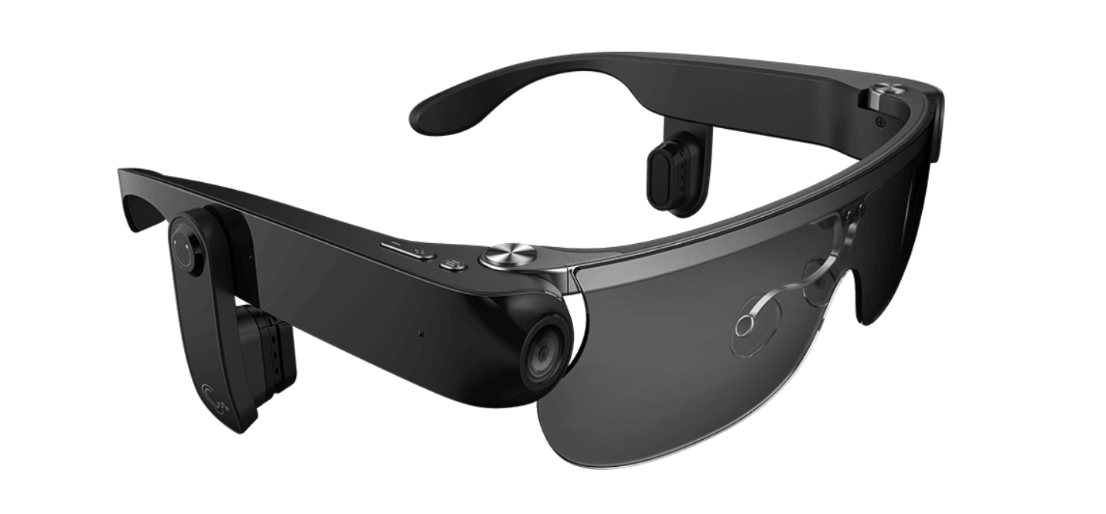
visual-assist glasses
c
Team member:
Lihan Zhao
Tianlei Shi
Zhichao Ma
Xingbo Wei
Hening Fan

Slide 2
Outline of design principle
Simple and Natural Dialog, Mental Model
Structure the interface
Speak the User’s Language
Provide Feedback
Modes easy to recognize and distinguish
Adaptable interface and shortcuts
Provide clearly marked exists and undo functionality

Slide 3
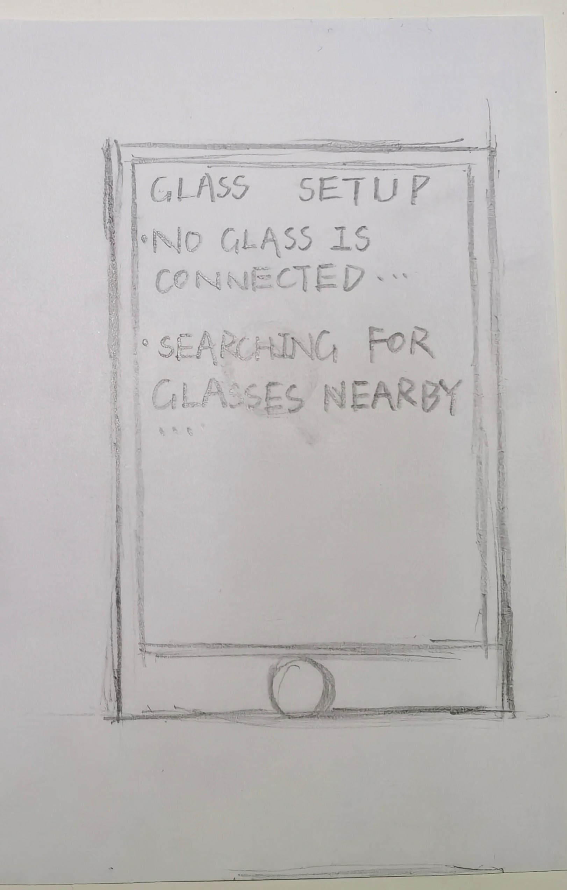
Simple and Natural Dialog, Mental Model
present exactly the information the user needs
Concise Information
Comfortable Service for Blind People
No Irrelevant Information
Easy to Find Item

Slide 4
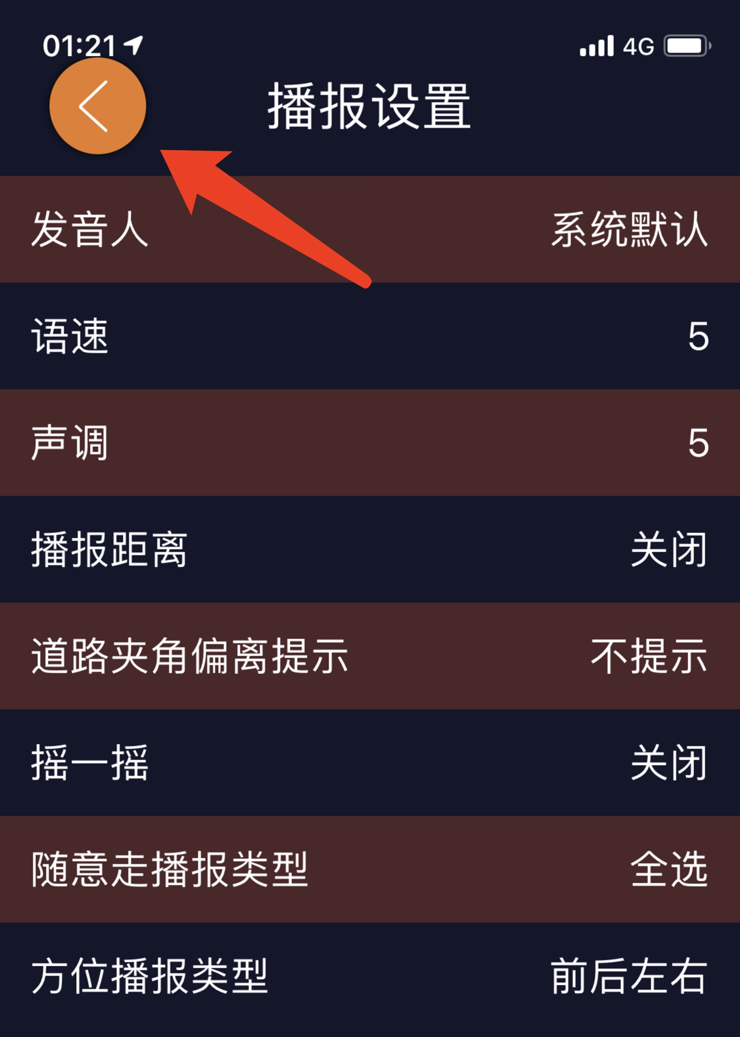
Structure the interface
Supports User’s Mental Model
Order by importance
Arranged more Logically and Reasonably
Convenient for Blind Person

Slide 5
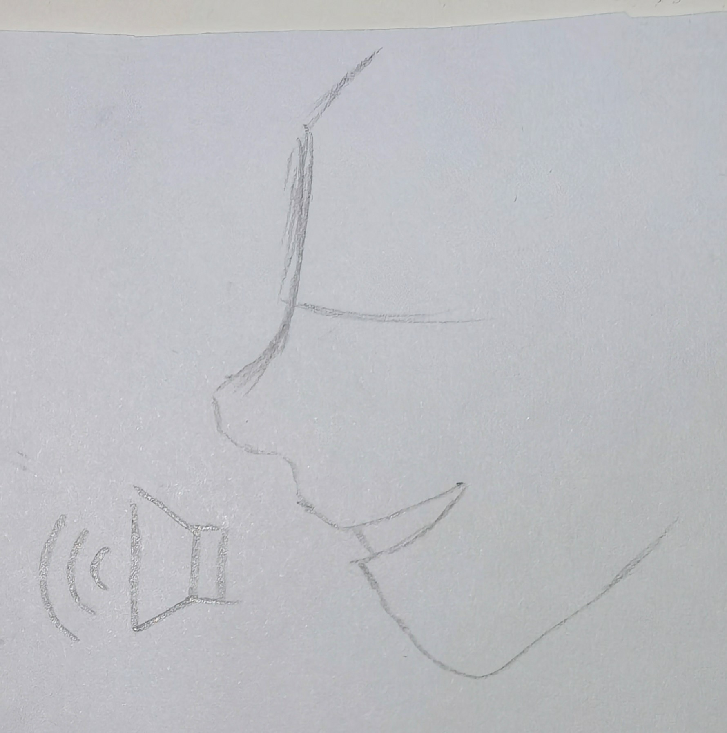
Speak the User’s Language
Audio Signals
Gives User Instructions on How to Operate the Glasses
Transferred to the Users by Voice Through the Headphones
Clicking on Different Icons

Slide 6
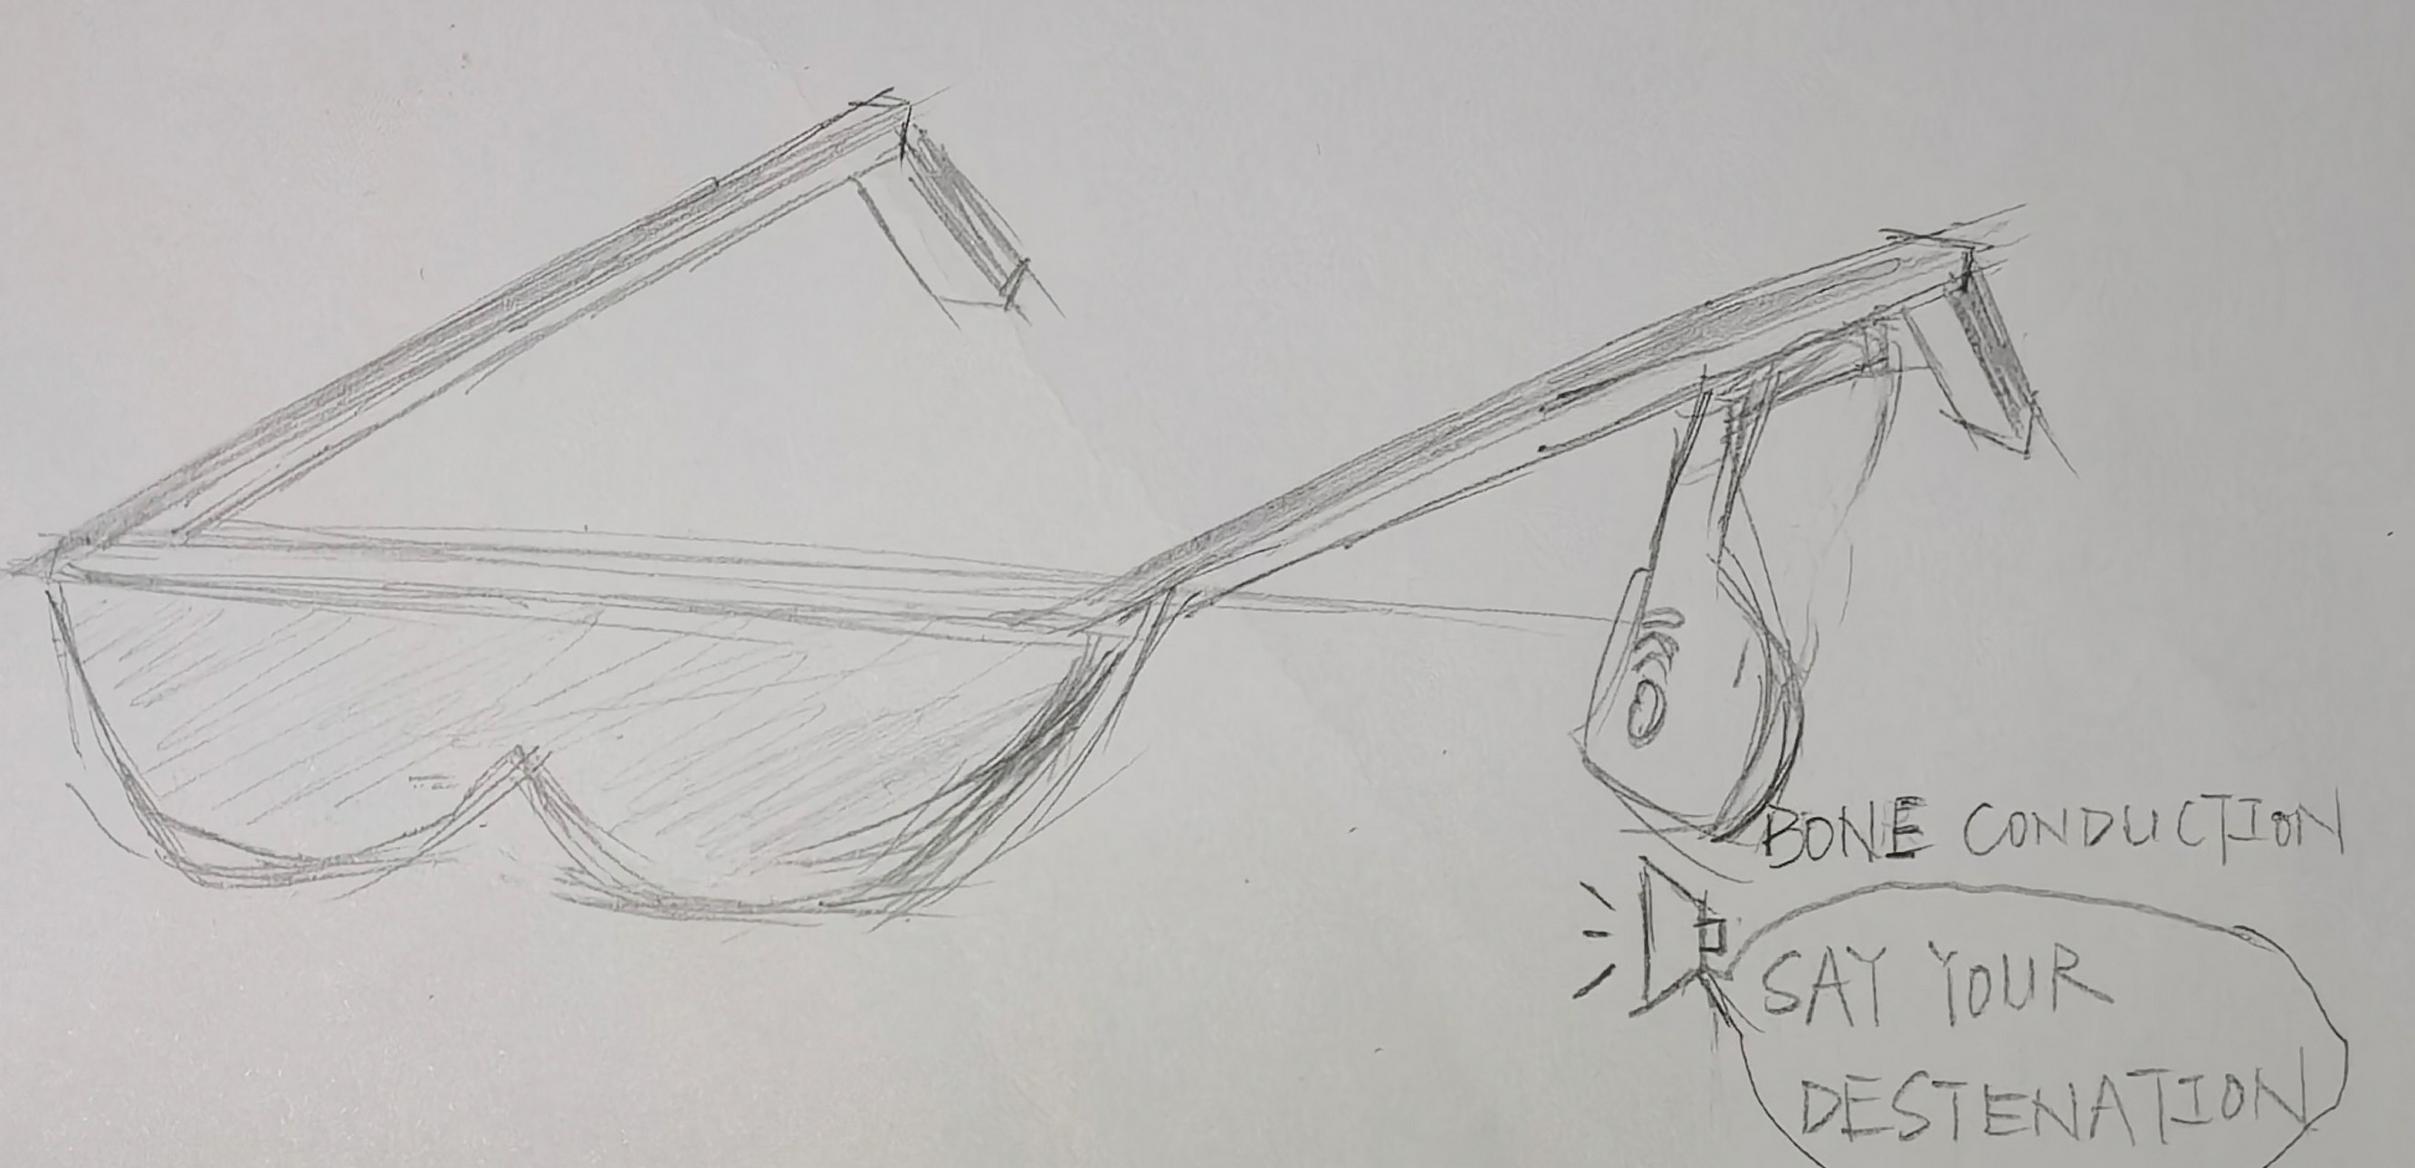
Provide Feedback
Inform Users What the System is Doing (e,g,
remind the time of diversion）
Respond Quickly
Let Blind Person Relieved

Slide 7
Modes easy to recognize and distinguish
Press Button Mode
Press once start the navigation mode
Press Twice start the recognition
Voice Interaction
Let User Precise interact with glasses

Slide 8
Adaptable interface and shortcuts
Press Button Once
Navigation Mode
Press Button Twice
Recognize Mode
Provide React Different Type
Reading Mode

Slide 9
Provide clearly marked exists and undo functionality
Cancel the Navigation and re-Navigate(if user press the error button)
Cancel some Situations(when the system occur some bug)

Slide 10
Conclusion
We can Predict how Users will likely React to your Design.
Make the Design Adaptable and Logical

Slide 11
Thank you

